Slide 1
Firewalls and NAT
  Firewall: A network security system designed to prevent unauthorized access to or from a private network. Firewalls can be implemented as both hardware and software, or a combination of both. Network firewalls are frequently used to prevent unauthorized Internet users from accessing private networks connected to the Internet, especially intranets

Slide 2
Firewalls and NAT
  Types of firewalls
  Network layer or Packet Filters
    Stateful - Stateful firewalls maintain context about active sessions, and use that “state information” to speed packet processing
    Stateless - Stateless firewalls require less memory, and can be faster for simple filters that require less time to filter than to look up a session. Hence these firewalls operate faster than that of the Stateful firewall as these firewalls have no concept of a session.

Slide 3
Firewalls and NAT
  Types of firewalls
  Proxy Firewalls:
    Proxy firewalls are considered to be the most secure type of firewall because they prevent direct network contact with other systems
    Proxy firewall acts as an intermediary between inside clients and servers on the Internet
    Generally works at layer 7

Slide 4
Firewalls and NAT
  NAT – Network Address Translation
  The process where a network device, usually a firewall, assigns a public address to a computer (or group of computers) inside a private network
  Limits the number of public IP addresses a company or individual must use
  Stopgap for the limited IP address numbers in IPv4
  Nat provides limited security by not allowing outside communication directly to the “private” IP addresses
  Supports coexistence of multiple address realms thus when ISP;s change you don’t have to change IP addresses

Slide 5
Firewalls and NAT
  NAT can also use port identification to help differentiate where the packets go
  NAT conserves the number of public addresses used within an organization, and it allows for stricter control of access to resources on both sides of the firewall

Slide 6
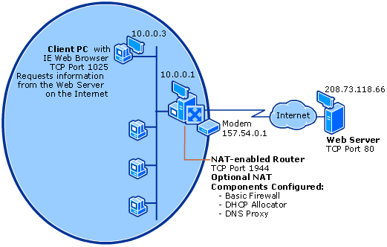
Firewalls and NAT

